Slide 1
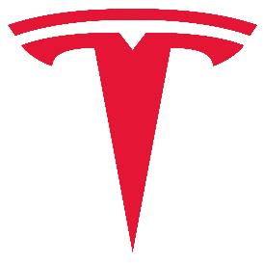
Case Study of Tesla
Knowledge Management Project

Slide 2
Knowledge Management
Project Title: Case study of Tesla
Project Guide: Prof.Krupesha
Project Team: 2

Slide 3
Team
Mayur RB - PES1201700714
Jnanesh D - PES1201701822
Sachin - PES1201701725
Sujay Gad - PES1201700177
Revanth Yalipi - PES1201700201

Slide 4
Project Abstract and Scope
In this project we dig into Tesla Inc and find out its working, products offered their Business strategies and a case study to find out how they popularised electric cars and we also find out the problems they currently face

Slide 5
Introduction
Tesla, Inc. (formerly Tesla Motors, Inc.), is an American electric vehicle and clean energy company based in Palo Alto, California
The company specializes in electric vehicle manufacturing, battery energy storage from home to grid scale and, through its acquisition of SolarCity, solar panel and solar roof tile manufacturing.
Tesla Motors was founded in July 2003 by engineers Martin Eberhard and Marc Tarpenning. The company's name is a tribute to inventor and electrical engineer Nikola Tesla

Slide 6
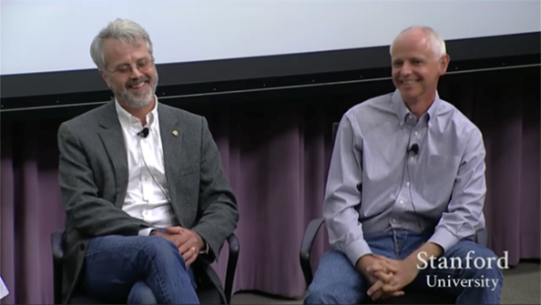
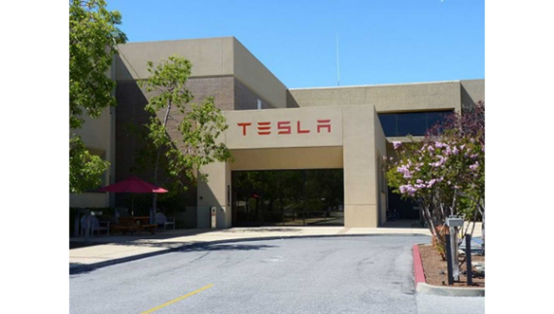
Introduction
Founders Martin Eberhard and Marc Tarpenning
Tesla Headquarters at Palo Alto

Slide 7
Introduction
Elon Musk was responsible for 98% of the initial funding, and served as chairman of the board. He appointed Martin Eberhard to be the first CEO. In its 2004] Series A funding, Tesla Motors was joined by Elon Musk, J. B. Straubel and Ian Wright, all of whom are retroactively allowed to call themselves co-founders of the company.
Musk, who formerly served as chairman and is the current CEO, said that he envisioned Tesla Motors as a technology company and independent automaker, aimed at eventually offering electric cars at prices affordable to the average consumer. In February 2017, Tesla Motors shortened its name to Tesla.

Slide 8
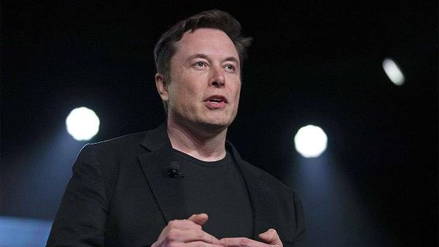
Introduction
Elon Musk

Slide 9
Introduction
After 11 years in the market, Tesla ranked as the world's best-selling plug-in as well as best-selling battery electric passenger car manufacturer by cars sold in 2019, both as a brand and by automotive group, with a market share of 17% of the plug-in segment and 23% of the battery electric segment. Tesla global vehicle sales increased 50% from 245,240 units in 2018 to 367,849 units in 2019.

Slide 10
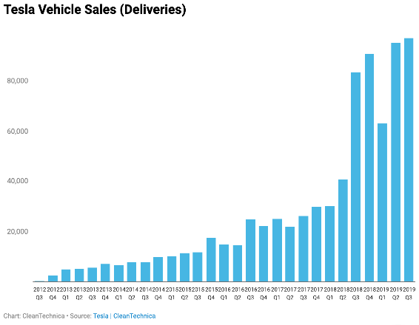
Introduction
Tesla’s Quarterly sales from 2012

Slide 11
History
Tesla Motors was incorporated in July 2003 by Martin Eberhard and Marc Tarpenning with 98% of the initial funds being provided by Chairman of the Board Elon Musk, who appointed Eberhard to be the first CEO.
The founders were influenced to start the company after GM recalled all its EV1 electric cars in 2003 and then destroyed them,] and seeing the higher efficiency of battery-electric cars as an opportunity to break the usual correlation between high performance and low mileage.

Slide 12
History
Elon Musk led the Series A round of investment in February 2004, joining Tesla's board of directors as its chairman.
Musk took an active role within the company and oversaw Roadster product design at a detailed level. In addition to his daily operational roles, Musk was the controlling investor in Tesla from the first financing round, funding $6.5 million of the Series A round of US$7.5 million with personal funds

Slide 13
History
Tesla's primary goal was to commercialize electric vehicles, starting with a premium sports car aimed at early adopters and then moving into more mainstream vehicles, including sedans and affordable compacts

Slide 14
Strategy
Tesla's business strategy is to emulate typical technological-product life cycles and initially target affluent buyers, and then move into larger markets at lower price points.
The battery and electric drivetrain technology for each model would be developed and partially paid for through the sales of earlier models.
The Roadster was low-volume and priced at US$109,000. Model S and Model X target the broader luxury market. Model 3 and the Model Y are aimed at a higher-volume segment.

Slide 15
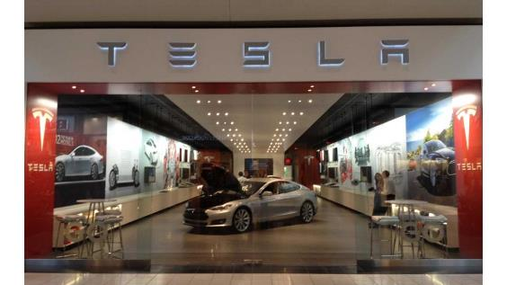
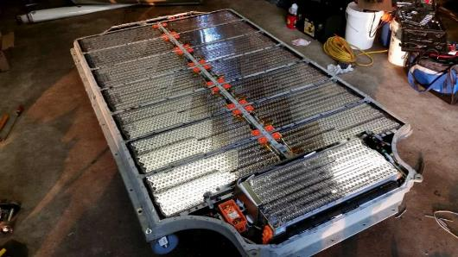
Strategy
A Tesla Dealership in Chicago IL
Tesla’s Lithium ion battery

Slide 16
Strategy
This business strategy is common in the technology industry. According to a Musk blog post, "New technology in any field takes a few versions to optimize before reaching the mass market, and in this case, it is competing with 150 years and trillions of dollars spent on gasoline cars."
Tesla's production strategy includes a high degree of vertical integration (80% in 2016), which includes component production and proprietary charging infrastructure. The company operates large factories to capture economies of scale. Vertical integration is rare in the automotive industry, where companies typically outsource 80% of components to suppliers, and focus on engine manufacturing and final assembly.

Slide 17
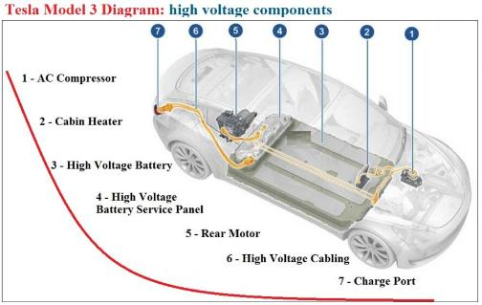
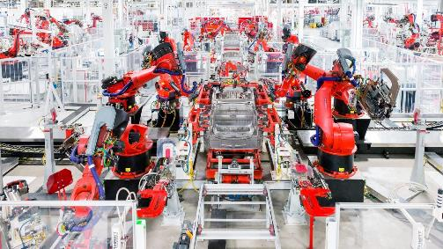
Strategy
Tesla Assembly Line
A Diagram Depicting the different components of a Tesla Model 3

Slide 18
Strategy
The Tesla Patent Wall at its headquarters was removed after the company announced its patents are part of the open source movement.
Tesla's sales strategy is to sell its vehicles online and in company-owned showrooms rather than through a conventional dealer network. Moving towards an e-commerce strategy, customers are able to customize and order their vehicles online

Slide 19
Strategy
Tesla's sales strategy is to sell its vehicles online and in company-owned showrooms rather than through a conventional dealer network. Moving towards an e-commerce strategy, customers are able to customize and order their vehicles online

Slide 20
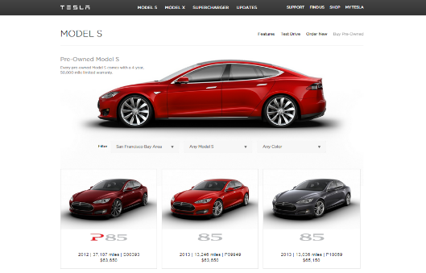
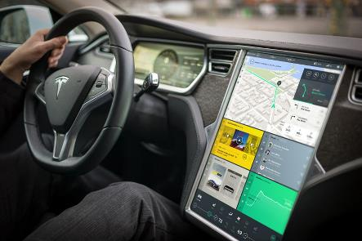
Strategy
A screengrab of the Tesla Website
Tesla Model S driver UI

Slide 21
Strategy
Tesla allows its technology patents to be used by anyone in good faith. Licensing agreements include provisions whereby the recipient agrees not to file patent suits against Tesla, or to copy its designs directly.
Tesla retained control of its other intellectual property, such as trademarks and trade secrets to prevent direct copying of its technology.

Slide 22
Strategy
Tesla Human Resources VP Arnnon Geshuri committed to bringing manufacturing jobs "back to California“.
In 2015, Geshuri led a hiring surge about which he said: "In the last 14 months we've had 1.5 million applications from around the world

Slide 23
KM Roles at Tesla:
1)Knowledge manager-
Roles and responsibilities include working cross-functionally with Product Managers, Training Program Managers and technical writers to develop effective, interesting, and engaging knowledge management solutions for the Energy products at Tesla.
. Standardize content across each Product informational repository for consistent and relevant information for all functional teams. Gather usability feedback from end-users for continual format and delivery improvements.

Slide 24
KM Roles at Tesla:
2)Knowledge management administrator-
The Knowledge Management Administrator is responsible for actively collaborating with IT counterparts to continue development and completion of a high quality, user-friendly sales and service knowledge management system (called TRT) that can be leveraged by Retail Development, as well as its internal business partners and external vendors.

Slide 25
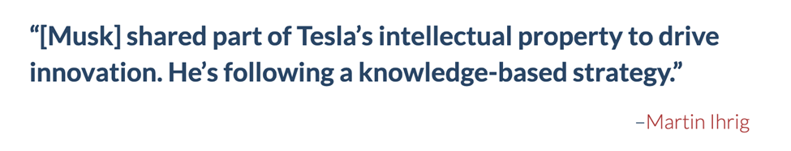
How Tesla has taken advantage of KM-

Slide 26
How Tesla has taken advantage of KM-
Tesla took a gamble by sharing patents that covered its revolutionary electric vehicles for free. Sharing of patents could have resulted in competitors catching up but the pro was that sharing of patents was a claim of authenticity which resulted in brand enhancement.
.Thus, the best engineers would flock to Tesla, attracted by its spirit of openness, innovation and dedication to a social mission. In this way knowledge assets (patents) were used by Tesla in the growth of the company.

Slide 27
Technologies of the company
1 . Batteries
Unlike other automakers, Tesla does not use individual large battery cells, but thousands of small, cylindrical, lithium-ion commodity cells like those used in consumer electronics
Tesla's batteries are manufactured in Gigafactories, the name Gigafactory comes from the word 'Giga,' the unit of measurement representing “billions.” It uses a version of these cells that is designed to be cheaper to manufacture and lighter than standard cells by removing some safety features.

Slide 28
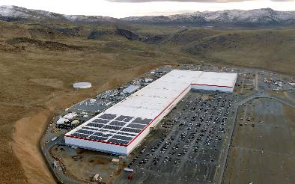
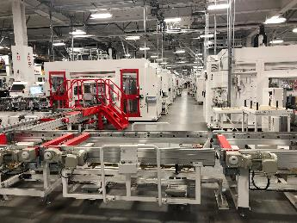
Technologies of the company
Giga Nevada
Inside a Giga Factory

Slide 29
Technology: Batteries
According to Tesla, these features are redundant because of the advanced thermal management system and an intumescent chemical in the battery to prevent fires. Panasonic is the sole supplier of the cells for Model S, Model X, and Model 3 and cooperates with Tesla in the Giga Nevada's '21–70' cells.
The batteries are placed under the vehicle floor. This saves interior and trunk (boot) space but increases the risk of battery damage by debris or impact. The Model S has 0.25 in (6.4 mm) aluminum-alloy armour plate.
Tesla has ongoing battery research and development work at Dalhousie University in Nova Scotia, Canada, featuring lead researcher Jeff Dahn. Tesla acquired two battery companies in 2019, Hibar Systems and Maxwell Technologies, all expected to play an important role in Tesla's battery strategy.

Slide 30
Technology
2.Motors
Tesla makes two kinds of electric motors. Their oldest currently-produced design is a three-phase four-pole AC induction motor with a copper rotor (which inspired the Tesla logo), which is used as the rear motor in the Model S and Model X.
Newer, higher-efficiency motors are used in the Model 3, Model Y, Semi, and the front motor of 2019-onward versions of the Model S and X. The permanent magnet motors increased efficiency, especially in stop-start driving

Slide 31
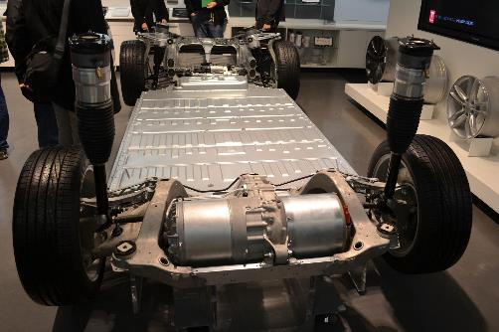
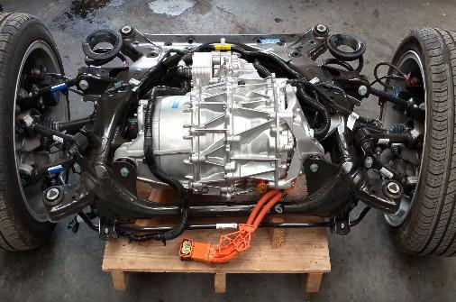
Technology
Base of a Tesla Model S
Drivetrain of a Tesla Model 3

Slide 32
Technology
3. Autopilot
In September 2014, Tesla Autopilot started providing semi-autonomous driver assist. Tesla upgraded its sensors and software in October 2016 (hardware version 2, or "HW2"); all Tesla cars built since then come standard with Autopilot hardware.
As of 2017, Autopilot included adaptive cruise control, lane departure warning, emergency braking, Autosteer (semi-automated steering), Auto park (parallel and perpendicular parking) and Summon (recalling the vehicle from a parking place).

Slide 33
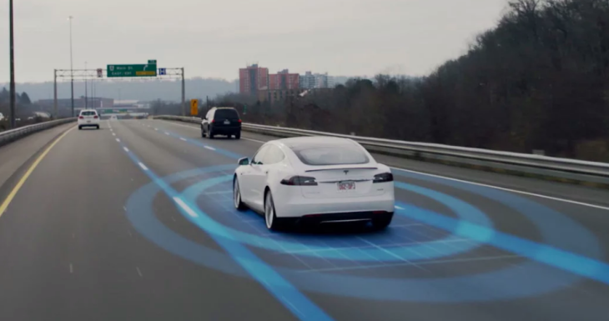
Techology
Tesla Autopilot

Slide 34
Technology(Autopilot)
At the end of 2016, Tesla expected to demonstrate full autonomy by the end of 2017, which was later expected by the end of 2019. In April 2017, Musk predicted that in around two years drivers would be able to sleep in their vehicle while it drives itself.
In April 2019, Tesla announced that all of its cars will include Autopilot (defined as just Traffic-Aware Cruise Control and Autosteer) as a standard feature moving forward.

Slide 35
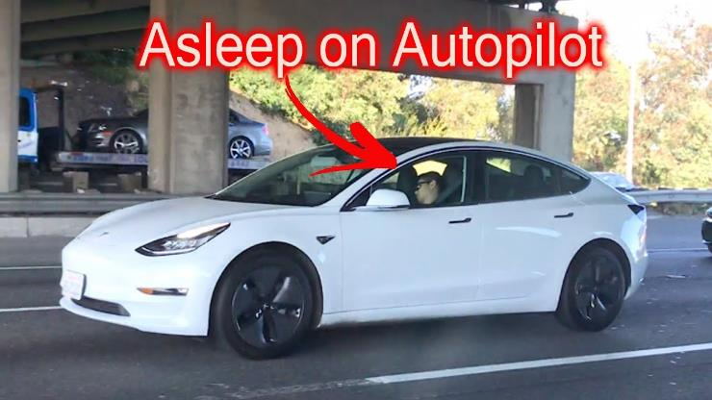
Technology(Autopilot)
A guy caught sleeping while driving a Tesla Model 3 in autopilot

Slide 36
Vehicle Models
As of January 2020, Tesla offers four car models: The Model S, Model 3, Model X and Model Y.
1 . Model S
The Model S is a five-door lift back sedan. Deliveries began on June 22, 2012. The first delivery in Europe took place in August 2013.

Slide 37
Vehicle Models
Deliveries in China began in April 2014.[200] First deliveries of the right-hand-drive model destined for the UK, Australia, Hong Kong and Japan came in 2014.
Norway is the Model S' largest European market due to the country's incentives for the adoption of pure electric cars.

Slide 38
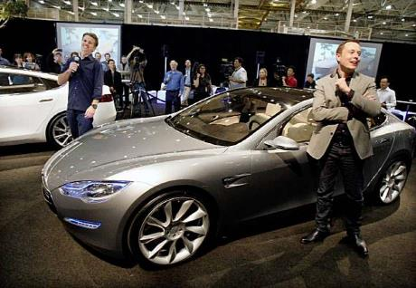
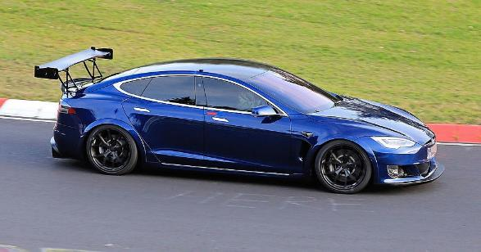
Vehicle Models
Tesla Model S being unveiled on Mar 26 2009 By Elon Musk
A Tesla Model S being tested in Nürburgring

Slide 39
Vehicle Models: Model S
With an estimated 50,931 units sold in 2016, the Model S ranked was the world's best-selling plug-in car for the second year in a row.
As of September 2018, the Model S, with global sales of 250,000 units, ranks as the world's second bestselling plug-in electric car in history after the Nissan Leaf (over 350,000 units).

Slide 40
Vehicle Models: Model S
The United States is the world's leading Model S market with an estimated 136,542 units sold through September 2018 Norway ranked as the Model S' largest overseas market as of November 2016, with 11,802 new units registered.
The Tesla Model S became the first electric car to top the monthly sales ranking in any country, when the electric car achieved first place in the Norwegian new car sales list in September 2013.

Slide 41
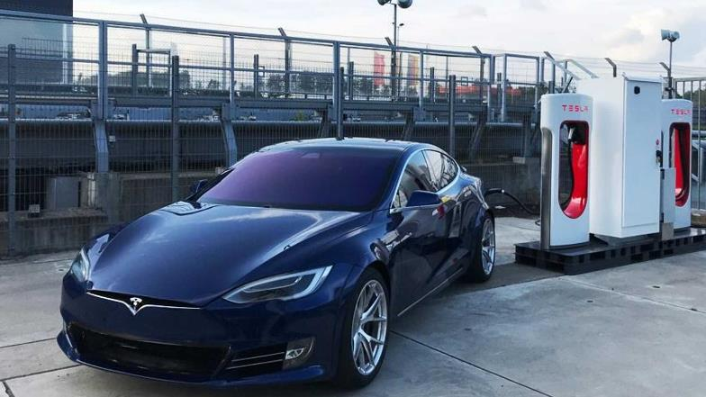
Vehicle Models: Model S
A Tesla Model S being recharged

Slide 42
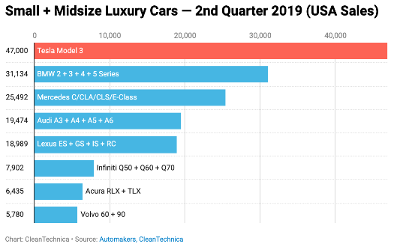
Vehicle Models : Model S
Comparison of Tesla Model S vs other Small+Midsize Luxury Cars (2nd quarter 2019 USA sales)

Slide 43
Vehicle Models
Model 3
The Model 3 (originally stylized as "☰"), a four-door sedan, is Tesla's third-generation car.
The car was originally intended to be called the Model E, but after a lawsuit from Ford that holds the trademark on "Model E”, Musk announced on July 16, 2014 that the car would be called "Model 3" instead.
On March 31, 2016, Tesla unveiled the car. Potential customers began to reserve spots on March 31 with a refundable deposit.
Tens of thousands were reported waiting to reserve their spot As of April 7, 2016, one week after the unveiling, Tesla reported over 325,000 reservations, representing sales of over US$14 billion.

Slide 44
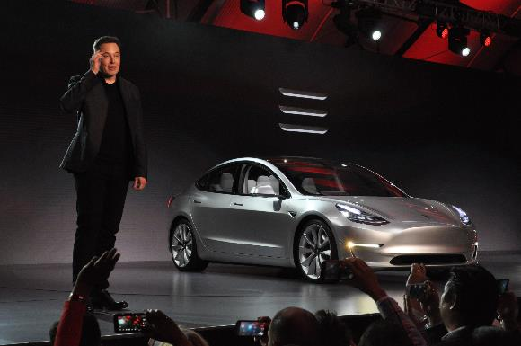
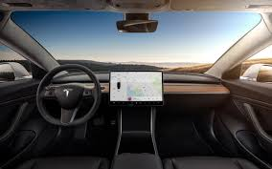
Vehicle Models
Elon Musk Unveiling the Model 3
Tesla Model 3 Interiors

Slide 45
Vehicle Models(Model 3)
As of July 2017, Tesla reported about 500,000 reservations. Bloomberg News claimed "the Model 3's unveiling was unique in the 100-year history of the mass-market automobile."
Bloomberg compared it to the 1955 Citroën DS that took in 80,000 deposits over 10-days at the Paris Auto Show.

Slide 46
Vehicle Models(Model 3)
Tesla expected to invest between US$2 billion and US$2.5 billion in capital expenditures to support Model 3 production.
Limited vehicle production began in July 2017, with the first 30 units delivered at a special event on July 28.
Customer deliveries totaled 1,764 units in the U.S. in 2017. In June 2018 production reached 5,000 per week.

Slide 47
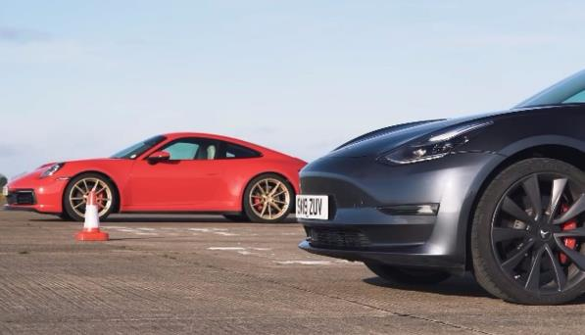
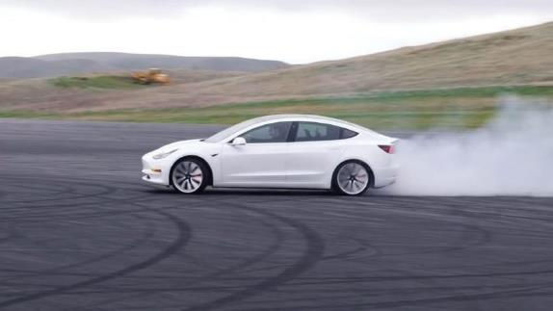
Vehicle Models(Model 3)
Tesla model 3 vs Porsche 911 Carrera
Tesla Model 3 in Track Mode

Slide 48
Vehicle Models
3. Model X
The Tesla Model X is a mid-size crossover SUV with a lightweight aluminum body.
Model X deliveries started in September 2015. It is offered in 5-, 6- and 7-passenger configurations.

Slide 49
Vehicle Models :Model X
Production was rescheduled several times, from 2013 to late 2014, to the second quarter of 2015, to the third quarter of 2015.
Deliveries of the Model X Signature series began on September 29, 2015. Model X sales totaled 2,400 units during the first quarter of 2016, rising to 4,638 in the second quarter of 2016.

Slide 50
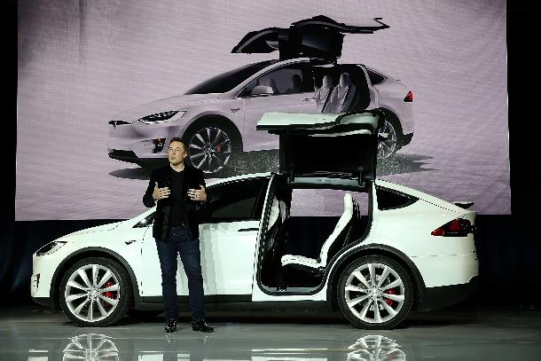
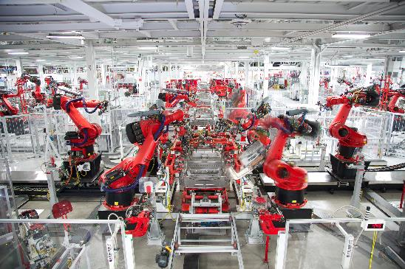
Vehicle Models
Elon Musk unveiling the Model X
Model X Assembly line at Freemont CA

Slide 51
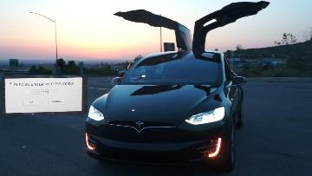
Vehicle Models : Model X
In September 2016, the Model X ranked as the top selling plug-in electric car in Norway.
Previously, the Model S had been the top selling new car four times. Cumulative sales since inception totaled 106,689 units through September 2018.
United States is its main market with an estimated 57,327 units sold through September 2018.
A Tesla Model X in Celebration Mode

Slide 52
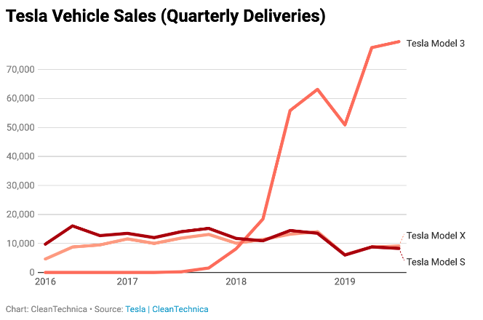
Vehicle Models : Model X
Quarterly Sales of Model X vs other Tesla models

Slide 53
Vehicle Models : Model Y
In August 2013, Tesla trademarked the name "Model Y”. In October 2015, Musk described a future "Model Y”. In August 2017, Tesla announced that the Model Y would use the Model 3 platform.
In February 2018, Tesla announced that they would unveil Model Y production plans within the next 3–6 months and posted open positions for Model Y production and design.
In May 2018, Musk said that the Model Y will be built on a platform that shares many components with the Model 3, and that the Model Y will be in production at the earliest in early 2020.

Slide 54
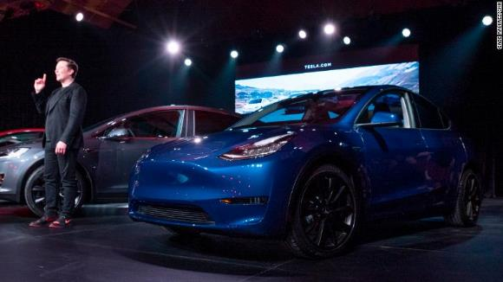
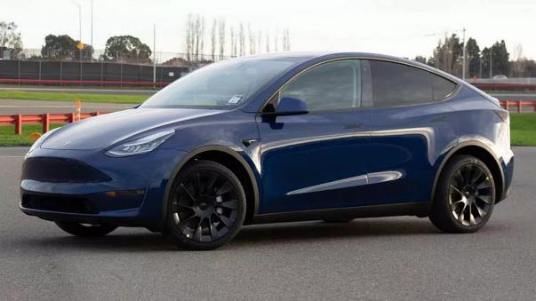
Vehicle Models : Model Y
Unveiling of Model Y

Slide 55
Table 1. Range and prices of Model 3,Model X, and Model S
Model and Version | Range | Base Price | Fully Loaded
Model 3 Standard Range Plus | 250 miles | $39,900 | $51,490
Model 3 Long Range | 322 miles | $48,990 | $60,490
Model 3 Performance | 322 miles | $56,990 | $66,990
Model S Long Range | 373 miles | $79,990 | $95,490
Model S Performance | 348 miles | $99,990 | $115,990
Model X Long Range | 328 miles | $84,990 | $106,490
Model X Performance | 305 miles | $104,990 | $128,490

Slide 56
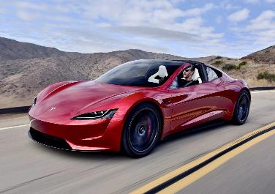
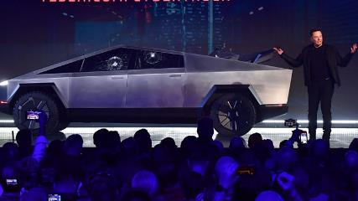
Upcoming models: Tesla Cybertruck price, Tesla Model Y price, and Tesla Roadster price
Model | Base Price | Max Price | Expected Launch
Cybertruck | $39,900 | $76,900 | Late 2022
Model Y | $48,800 | $74,000 | Early 2021
Roadster | $200,000 | $250,000 | Unclear
The Tesla Roadster
Tesla Cybertruck Unveiling

Slide 57
Factories And Markets
Tesla's first assembly plant occupies the former NUMMI plant in Fremont, California. It is known as the Tesla Factory.
As of 2016, the plant was not highly automated—it was expected to produce some 80,000 cars with 6,000 workers compared to a "typical" plant that might produce 250,000 cars with 3,000 workers.
In 2015, Tesla acquired Riviera Tool & Die (with 100 employees in Michigan), one of its suppliers of stamping items. In 2017, Tesla acquired Perbix Machine Company, a manufacturer of automated manufacturing equipment, that had been an equipment supplier for over three years.
Tesla occupies a second factory in Fremont. The building is more than 500,000 sq. ft (46,500 m2). The location is next to a SolarCity facility, a few miles from the original Fremont plant.

Slide 58
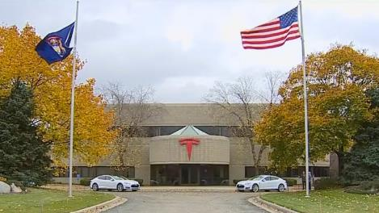
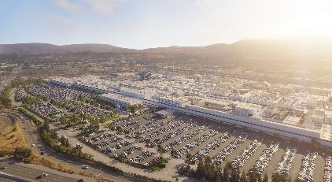
Factories And Markets
Tesla Factory : Freemont CA
Tesla Tool And Die Factory Michigan

Slide 59
Factories And Markets
Giga Nevada is located outside Reno, Nevada. As of January 2017, it occupied 1.9 million square feet (180,000 m2) with 4.9 million square feet (460,000 m2) of usable area across several floors.
It produces Power walls and Powerpacks as well as battery cells in partnership with Panasonic. It also produces Model 3 battery packs and drivetrains. The factory received substantial subsidies from the local and state governments.

Slide 60
Factories And Markets
Giga New York is located in Buffalo, New York on the site of a former Republic Steel plant. It is operated by Tesla's SolarCity unit.
The factory is a $750 million, 1.2-million-square-foot (0.11 km2) facility that directly employs 500 workers. Tesla partnered with Panasonic to assemble photovoltaic panel modules.

Slide 61
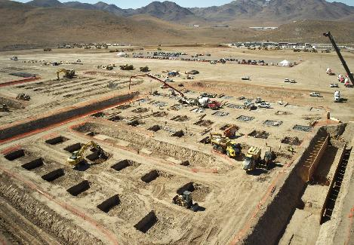
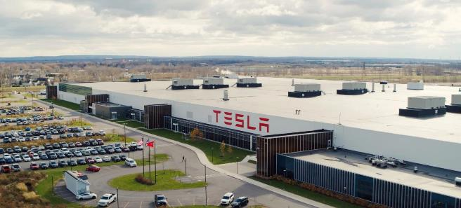
Factories And Markets
Giga Nevada under Construction
Giga New York

Slide 62
Factories And Markets
Tesla received incentives to locate the factory in Buffalo through the Buffalo Billion program. As of August 2017, the factory added production of solar tiles for the Tesla Solar Roof.
In January 2018, Tesla announced, after testing on employees' roofs, that it would begin installing the Tesla Solar Roof on customers' homes "within the next few months”.

Slide 63
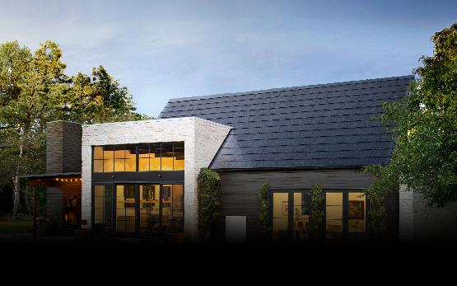
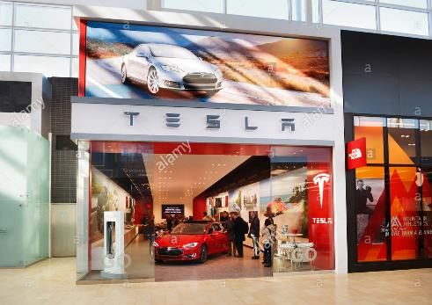
Factories And Markets
Tesla’s Solar roof tiles
Tesla Dealership in Ontario

Slide 64
Factories And Markets
In Europe
Tesla opened its first European store in June 2009 in London. Tesla's European headquarters are in Amsterdam.
A 62,000 sq. ft (5,800 m2) European service centre operates in Tilburg, Netherlands, along with a 77,650 m2 (835,800 sq ft) assembly facility that adds drivetrain, battery and software to the (imported) car body to reduce EU import tax.
In late 2016, Tesla acquired German engineering firm Grohman Engineering in Prüm as a new division dedicated to helping Tesla increase the automation and effectiveness of its manufacturing process.
After winding down existing contracts with other auto manufacturers, Grohman works exclusively on Tesla projects.

Slide 65
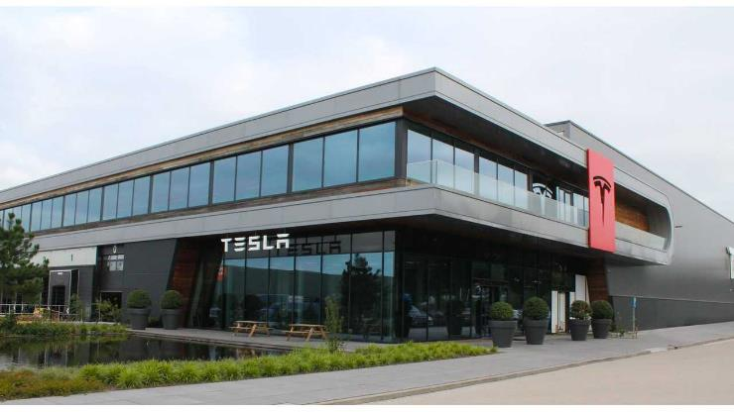
Factories And Markets
Tesla Facility In Tilburg, Netherlands

Slide 66
Factories And Markets : Europe
In June 2014 Tesla announced, and again confirmed in November 2016, its long-term plans to build a car and battery Gigafactory in Europe.
Several countries have campaigned to host. and in July 2018, it was reported that Tesla was exploring locating Gigafactory 4 in either Germany or the Netherlands.

Slide 67
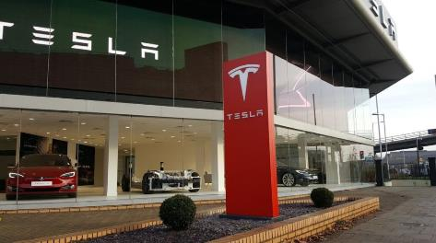
Factories And Markets : Europe
A location and plans to begin construction near Berlin were announced in November 2019. In 2020, after anti-Tesla protests and environmentalists' victory in the court, the car-maker has been forced to temporarily stop preparations for the launch of a factory in Germany.
Tesla Dealership in London, UK

Slide 68
Factories And Markets
In Asia
Tesla Motor's Japanese showroom in Aoyama, Tokyo, which was the first showroom opened in the country.
Showrooms and service centers operate in Hong Kong, Beijing and Shanghai. Tesla opened its first Japanese showroom in Tokyo, Japan, in October 2010.
In South Korea, it opened two showrooms in March 2017 and a service centre in late 2017. In August, 2017, Taiwan opened its first service centre and showroom.
In July 2018, Tesla signed an agreement with Chinese authorities to build a factory in Shanghai, China, which is Tesla's first Gigafactory outside of the United States.

Slide 69
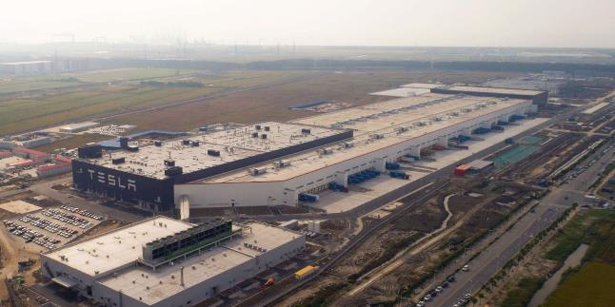
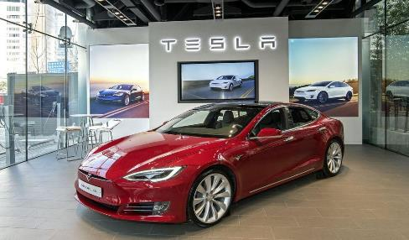
Factories And Markets
Giga Shanghai
Tesla Dealership in Seoul, SK

Slide 70
Factories And Markets
In Middle East
Tesla opened a showroom and a service centre in Dubai, United Arab Emirates, in 2017 as the first expansion of Tesla in the Middle East.
Five ultra-fast superchargers were also built between cities with a planned 50 destination chargers in the United Arab Emirates by the end of 2017.
One of the first Tesla customers was Dubai's Roads and Transport Authority which ordered 200 Tesla Model S and Model X vehicles that were added to Dubai Taxi Corporation's fleet.
In May 2017 the service centre and store in Amman Jordan was opened. In January 2020 a "pop-up" store in Tel Aviv Israel was opened and an R&D centre.

Slide 71
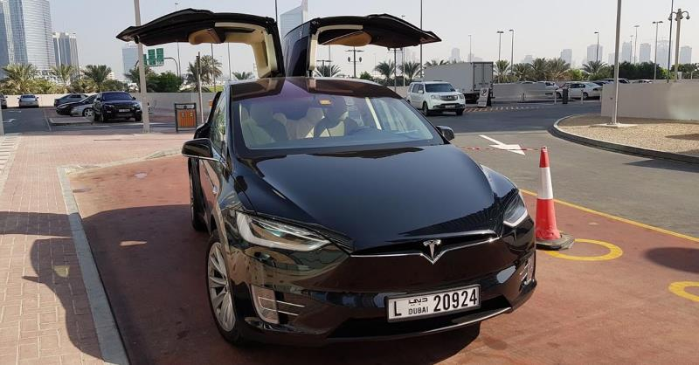
A Tesla Uber in Dubai
A Tesla Uber in Dubai

Slide 72
Factories And Markets
Australia
Tesla opened a showroom in Sydney's Martin Place in 2010, followed by a showroom and service centre in Melbourne in 2015. By 2019, Tesla had opened 4 service centers in Australia.
South America
In February 2020, several news sites reported that Tesla was negotiating with the Brazilian Minister of Science, Technology and Innovation, Marcos Pontes to build a Gigafactory in the state of Santa Catarina, Brazil.
Tesla vehicles could then be exported to other nearby markets, such as Argentina, Chile, Paraguay, Uruguay, Colombia, the Caribbean region, and even Mexico, a country with which Brazil has a free trade agreement.

Slide 73
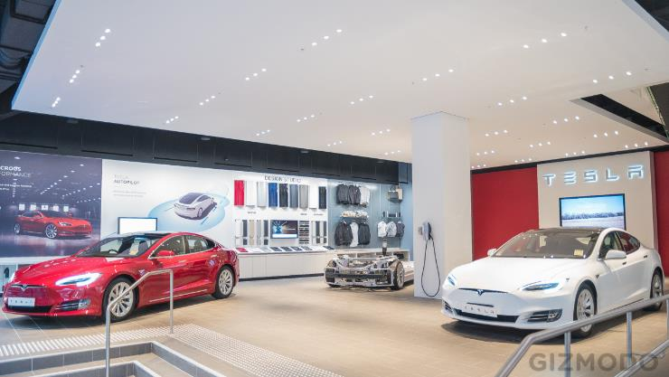
Tesla Dealership in Sydney

Slide 74
Case Study: How Tesla Changed the Auto Industry
Tesla is forcing the auto industry to rapidly change. Large, established automakers now are making fully electric and hybrid electric cars.
Automakers are starting to explore and include artificial intelligence (AI) in their cars, and now major automakers and U.S. Congressmen are discussing autonomous vehicles (AVs) and how best to innovate and regulate them.
Not only that, but Tesla's software design is state-of-the-art: the fact that Tesla can update vehicle software over-the-air (OTA) as if it were Apple updating an iPhone is unprecedented.

Slide 75
As cars become more tech-savvy, Tesla is in the lead.
But Tesla struggles to meet deadlines and frequently delivers flawed vehicles, and profitability remains elusive.
Many use Tesla's failings to argue that the company shouldn't be followed as an innovator or even as a true automaker.

Slide 76
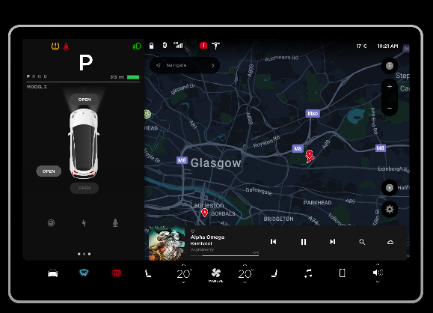
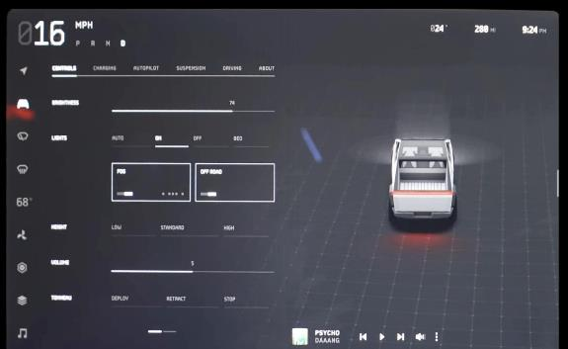
Case Study: How Tesla Changed the Auto Industry
Tesla Cybertruck User Interface
Tesla Model 3 User Interface

Slide 77
Case Study: How Tesla Changed the Auto Industry
Tesla is forcing the auto industry to change rapidly
Tesla didn't invent the electric car (Scottish inventor Robert Anderson did, in 1832), but it was Tesla who popularized, pioneered and promoted the electric car ever since the company's founding in 2003.
None of the major automotive manufacturers were making electric cars until Tesla made it cool in 2008 with its bombastic announcement of the first luxury electric car: The Tesla Roadster.

Slide 78
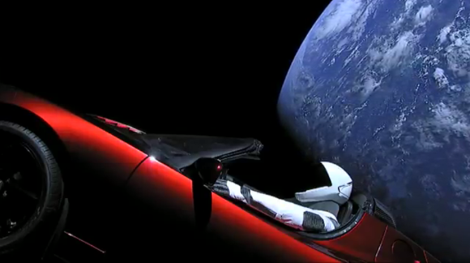
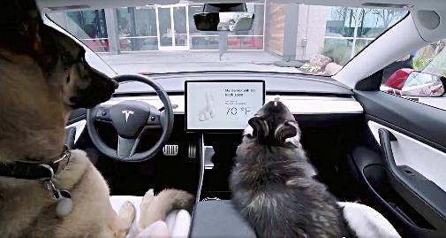
Case Study: How Tesla Changed the Auto Industry
Tesla Roadster orbiting earth
Tesla’s Dog Mode in Action

Slide 79
Case Study: Tesla is forcing the auto industry to change rapidly
Since then, big automakers with lots of capital, solid supplier bases and seasoned supply chains went to work in rapidly developing and churning out their own electric cars, as consumers and governments pursue eco-friendly, low-emissions transit options.
The next electric car, released in 2010, was made by Mitsubishi Motors. According to the Bureau of Transportation Statistics data, the number of hybrid EVs sold in the U.S. didn't break 100,000 until 2005.
The bureau doesn't have data on the number of EVs sold until 2011, which was 9,750.
Since then, the EV market has exploded. By 2015, 71,044 EVs were sold in the U.S., and 384,404 hybrid EVs. Between January and September 2017, Tesla led the pack by selling 73,227 EVs, followed by Chinese automaker BYD, selling 69,094.

Slide 80

Case Study: Tesla is forcing the auto industry to change rapidly
Brian Loh, a partner at McKinsey&Company;, said innovation is at an "all-time high" in the auto industry right now, which is significant because historically, the auto industry is very slow to evolve.
Tesla Model 3 ready to be shipped

Slide 81
Problems Faced By Tesla
Tesla's supply chain is it's Achilles' Heel
Tesla doesn't meet deadlines. Tesla doesn't meet market expectations. Tesla delivers cars riddled with defects. Last fall, Tesla missed Model 3 production goals in Q3 2017 due to supplier issues, and ended up having to redesign a key part of the Model 3.
What CEO Elon Musk called "production bottlenecks" continued through Q4 2017, although by then Tesla was no longer blaming suppliers, and told investors in February that the company would produce 5,000 Model 3s a week by the end of Q2 2018.
Almost all of these problems can be attributed to lack of funding and the fact that Tesla is still a small company.

Slide 82
Problems Faced By Tesla
Tesla's supply chain is still in the development phase, and right now Tesla doesn't have the capital and supplier relationships that other big automakers have. “For better or worse, Tesla makes its own batteries, so it's heavily dependent on its own sources," said Michelle Anderson, a partner with Boston Consulting Group.

Slide 83
Problems Faced By Tesla
Because Tesla's supply chain often relies on single source suppliers, one can quickly fit the puzzle pieces together to see how and why Tesla has struggled.
According to a Tesla statement provided by CSIMarket, the electric car manufacturer does have more supply chain volatility than other automakers.

Slide 84
Problems Faced By Tesla
“While we obtain components from multiple sources whenever possible, similar to other automobile manufacturers, many of the components used in our vehicles are purchased by us from a single source," the statement reads.
"To date, we have not qualified alternative sources for most of the single sourced components used in our vehicles and we generally do not maintain long-term agreements with our suppliers.

Slide 85

Problems Faced By Tesla
While we believe that we may be able to establish alternate supply relationships and can obtain or engineer replacement components for our single source components, we may be unable to do so in the short term or at all at prices or costs that are favorable to us.
Tesla Staff interacting with customers

Slide 86
Problems Faced By Tesla
Tesla suffers from a lack of funding and narrow supplier base
Supply chains are critical to an automaker's success, but the most critical part of the automaker's supply chain is its relationship with suppliers — and that might be where Tesla is weakest.
Typically, an OEM will have a supplier panel or a collection of a few suppliers, anywhere from 2-5 suppliers they source from for that commodity.

Slide 87
Problems Faced By Tesla
Then there's the funding problem. Tesla is technically still in the red — the company isn't profitable yet, and many critics use that fact as their main reason for arguing that Tesla isn't worth investment or even worth paying attention to.
But when it comes to suppliers, Tesla's lack of funding is a huge issue. For example, Tesla is trying to ramp up production of the Model 3, necessitating a high volume of parts and components from its suppliers. Because of that capital outlay, Tesla might hold off on paying upfront costs for the parts and wait until the car starts selling before paying suppliers.

Slide 88
Problems faced by Tesla
But because Tesla is still learning how to mass produce electric cars — relatively speaking, Tesla is still new to the auto industry — production problems still arise, making it increasingly difficult to sell and deliver quality cars at an efficient rate.
Tesla Deliver’s on its promises, just not always on time
For all of the problems Tesla is now experiencing with the Model 3, the company already experienced with the Model S.

Slide 89

Problems faced by Tesla
At this point, most of the wrinkles in Model S production have been ironed out. That may instill some hope in investors, but the fact remains that Tesla still has inroads to make as a trusted automaker.

Slide 90
Problems faced by Tesla
Tesla has proved is that it takes a tremendous amount of funding, grit and hard work, star power and a strong vision in order to succeed in the auto industry and launch a radical new product — especially if you're trying to do both those things at the same time.
The fact that Tesla is still around 15 years after its commencement is impressive all by itself. "On one hand, ramping up a car company from scratch is really hard," said Greg Keffer, vice president of marketing at GT Nexus.
Tesla shows how crucial it is for an automaker — or any company, really — to have all the kinks worked out of its supply chain before pursuing such big goals, like skipping the prototype stage and rushing to produce 5,000 cars a week right away, which is how Tesla approached the Model 3.

Slide 91

Problems faced by Tesla
Porsche Taycan Tesla’s New Rival

Slide 92

Additional Info: Stock Prices
A Graph showing the rise and fall in the stock prices of tesla over the last 10 years

Slide 93
Conclusion
Tesla has struck the right cords in terms of marketing, Tesla did not hire a single celebrity to market its products , Tesla let the features of the car speak for themselves.
Tesla has managed to change the general perspective that people had on electric cars
Elon Musk managed to capture the “meme industry” to further market tesla

Slide 94


Conclusion
A Meme edition Tesla S
A meme made on the Cybertruck launch

Slide 95
Conclusion
Although Tesla scores top points in terms of marketing and features , where it lags behind is in terms of delivery.
The major reason behind this failure is due to the supply chain problems that tesla faces due to its parts suppliers
To avoid retail delays and problems associated with dealerships , Tesla is moving online, Tesla has started selling its products online in select regions , to make the life of an average consumer easy.

Slide 96
Relevance of this project
From this project we can find out the weaknesses of the company, and how to improve those problems and improve their brand by hiring the right expert to resolve these issues
We can find out the policies related to their rights of intellectual property access
And other companies can use some of Tesla’s strategies and ideas to improve their brand

